Slide 1

SMART TRANSPORTATION
-
PHASE-2

Slide 2
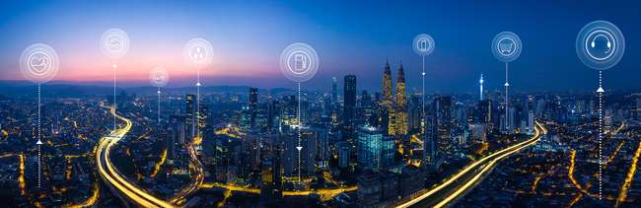
INNOVATION:-
Smart public transportation optimization involves the use of various technologies and systems to enhance the efficiency, safety, and accessibility of public transit services. Here are details on the components and technologies commonly used in smart public transportation optimization.

Slide 3

After thorough research, we came up with an innovative idea to solve the
problems that we have mentioned in phase 1 of our project.
Sensor
> Cameras, Lidar, Radar, Ultrasonic sensors
> GPS, Patient Monitoring Devices, Collision Detection Sensors
> Axle Counters, Train Health Monitoring Sensors, Speed Sensors
> Passenger Counting Sensors, Environmental Sensors, Door Sensors
Connectivity
> DSRC
>MDTs, ESN, Satellite Communication
> Trackside Communication
> Wireless Communication Networks

Slide 4
Cloud
> Alert Generation, Data Sharing
> Data Analytics and Reporting
Protocol
> IEEE 802.11p
> EMS, Communication Protocols
> Train control Protocols
> ITS
Public Platform
> Smart City Initiatives, TMA,
> Public Alert Systems, IHS
> Passenger Information Systems
> Transit Apps

Slide 5
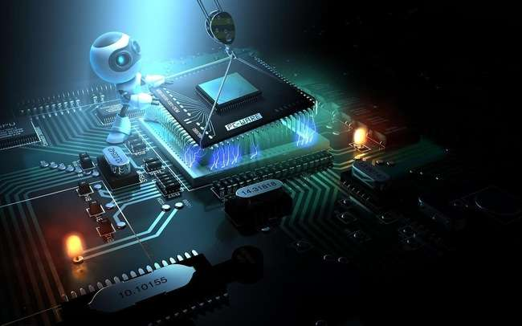
SENSORS:-
Cameras: Vehicles are often equipped with cameras that can capture images and videos of the surroundings. These cameras can be used for pedestrian detection and recognition.
Lidar (Light Detection and Ranging): Lidar sensors use laser beams to create detailed 3D maps of the environment around the vehicle. They can accurately detect pedestrians and their movements.
Radar: Radar sensors emit radio waves and measure the time it takes for the waves to bounce back after hitting objects. Radar is effective at detecting pedestrians, even in adverse weather conditions.
Ultrasonic Sensors: These sensors use sound waves to detect nearby objects and can contribute to proximity sensing, especially at lower speeds.
GPS (Global Positioning System): GPS sensors provide real-time location data for ambulances, enabling dispatchers to track their positions, optimize routing, and provide accurate estimated arrival times to emergency scenes and hospitals.
Patient Monitoring Devices: Ambulances may be equipped with advanced patient monitoring devices that can continuously track a patient's condition during transport and transmit this data to healthcare providers in real-time.

Slide 6
Axle Counters: Axle counters are used for train detection and to maintain accurate train spacing. They help prevent collisions and manage train traffic.
Train Health Monitoring Sensors: Sensors can be installed on trains to monitor the condition of critical components such as brakes, bearings, and suspension systems. This data helps in predictive maintenance and reduces downtime.
Speed Sensors: Speed sensors are used to monitor train speed, ensuring that trains adhere to speed limits and operate safely.
GPS (Global Positioning System): GPS sensors are used to track the real-time location of buses. They enable route planning, schedule adherence, and accurate arrival time predictions.
Passenger Counting Sensors: Sensors placed at bus doors or inside the vehicle count passengers as they board and disembark. This data aids in optimizing routes and resource allocation.
Door Sensors: These sensors detect door opening and closing, ensuring safe boarding and alighting of passengers
Collision Detection Sensors: These sensors can detect accidents or sudden deceleration and trigger emergency alerts or safety measures, such as airbag deployment.

Slide 7
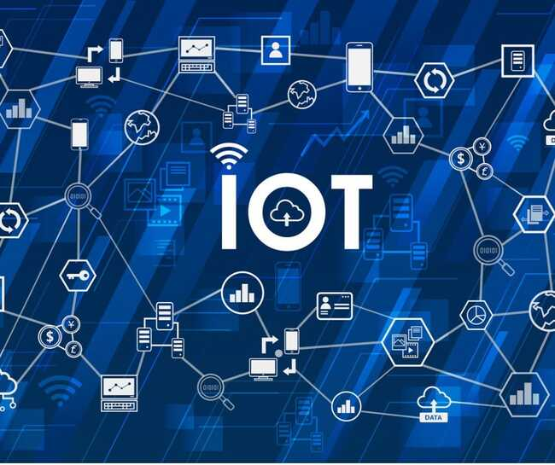
CONNECTIVITY:-
Dedicated Short-Range Communications (DSRC): DSRC is a wireless communication protocol designed for V2X communication, including V2P. It operates in the 5.9 GHz frequency band and allows vehicles to exchange safety-related information with pedestrians and other road users.
Mobile Data Terminals (MDTs): MDTs provide a link between ambulances and dispatch centers, hospitals, and healthcare professionals. They enable the exchange of patient information, routing instructions, and communication with medical experts.
Satellite Communication: In areas with poor or no cellular coverage, ambulances may rely on satellite communication to maintain connectivity.
Emergency Services Network (ESN): Some regions have dedicated emergency services networks that prioritize communication for first responders, including ambulances, ensuring they have reliable connectivity during emergencies.
Trackside Communication: Fiber-optic or wireless communication networks along the tracks enable data transfer between trains and control centers. These networks are used for signaling, train control, and real-time updates.
Wireless Communication Networks: Buses use wireless networks, including cellular and Wi-Fi, for passenger Wi-Fi access, real-time data exchange with control centers, and fleet management.

Slide 8

CLOUD:-
Alert Generation: Cloud services can generate alerts and warnings for drivers and pedestrians based on real-time V2P data
Data Sharing: Cloud platforms may facilitate data sharing between vehicles, infrastructure, and pedestrians to enhance safety.
Data Analytics and Reporting: Cloud-based data analytics platforms can analyze ambulance operations data, including response times, routes, and patient outcomes, to identify areas for improvement and optimize services….. Cloud platforms analyze data from various sensors and systems to provide insights into train operations, passenger flow, and system efficiency….. Cloud-based platforms analyze data from sensors, passenger counts, and vehicle locations to optimize bus routes, schedules, and resource allocation.

Slide 9

PROTOCOL:-
IEEE 802.11p: This is a standard designed for wireless access in vehicular environments (WAVE) and is commonly used for V2X communication, including V2P.
Emergency Medical Services (EMS) Protocols: EMS protocols define the procedures and guidelines that paramedics and emergency medical technicians (EMTs) follow during patient assessment, treatment, and transportation. Optimization efforts may involve streamlining these protocols for efficiency.
Communication Protocols: Ambulance crews follow established communication protocols to ensure clear and efficient communication with dispatch centers, hospitals, and other first responders.
Train Control Protocols: Train control systems use various protocols for communication between trains and the central control center. Common protocols include European Train Control System (ETCS), Positive Train Control (PTC), and others.
Intelligent Transportation System (ITS) Protocols: ITS protocols enable communication between buses, traffic management centers, and passenger information systems, allowing for real-time updates and coordination.

Slide 10

PUBLIC PLATFORM:-
Smart City Initiatives: Smart cities may invest in infrastructure that supports V2P communication, including sensors, roadside equipment, and data platforms.
Traffic Management Authorities(TMA): Traffic management authorities can use V2P data to enhance pedestrian safety and improve traffic flow.
Public Alert Systems: Public alert systems and mobile apps may provide real-time information to the public about emergency situations, including ambulance responses and safety instructions.
Integrated Healthcare Systems(IHS): In regions with integrated healthcare systems, ambulances are part of a larger network that coordinates pre-hospital care, emergency departments, and follow-up care for patients.
Passenger Information Systems: These systems provide real-time information to passengers regarding train schedules, delays, and platform changes. Public information displays and mobile apps are common interfaces.
Transit Apps: Transit apps provide real-time information to passengers, allowing them to plan routes, check schedules, and receive alerts about delays or disruptions.

Slide 11

THANK YOU

